Slide 1
HOW NOW SHALL WE LOVE?

Slide 2
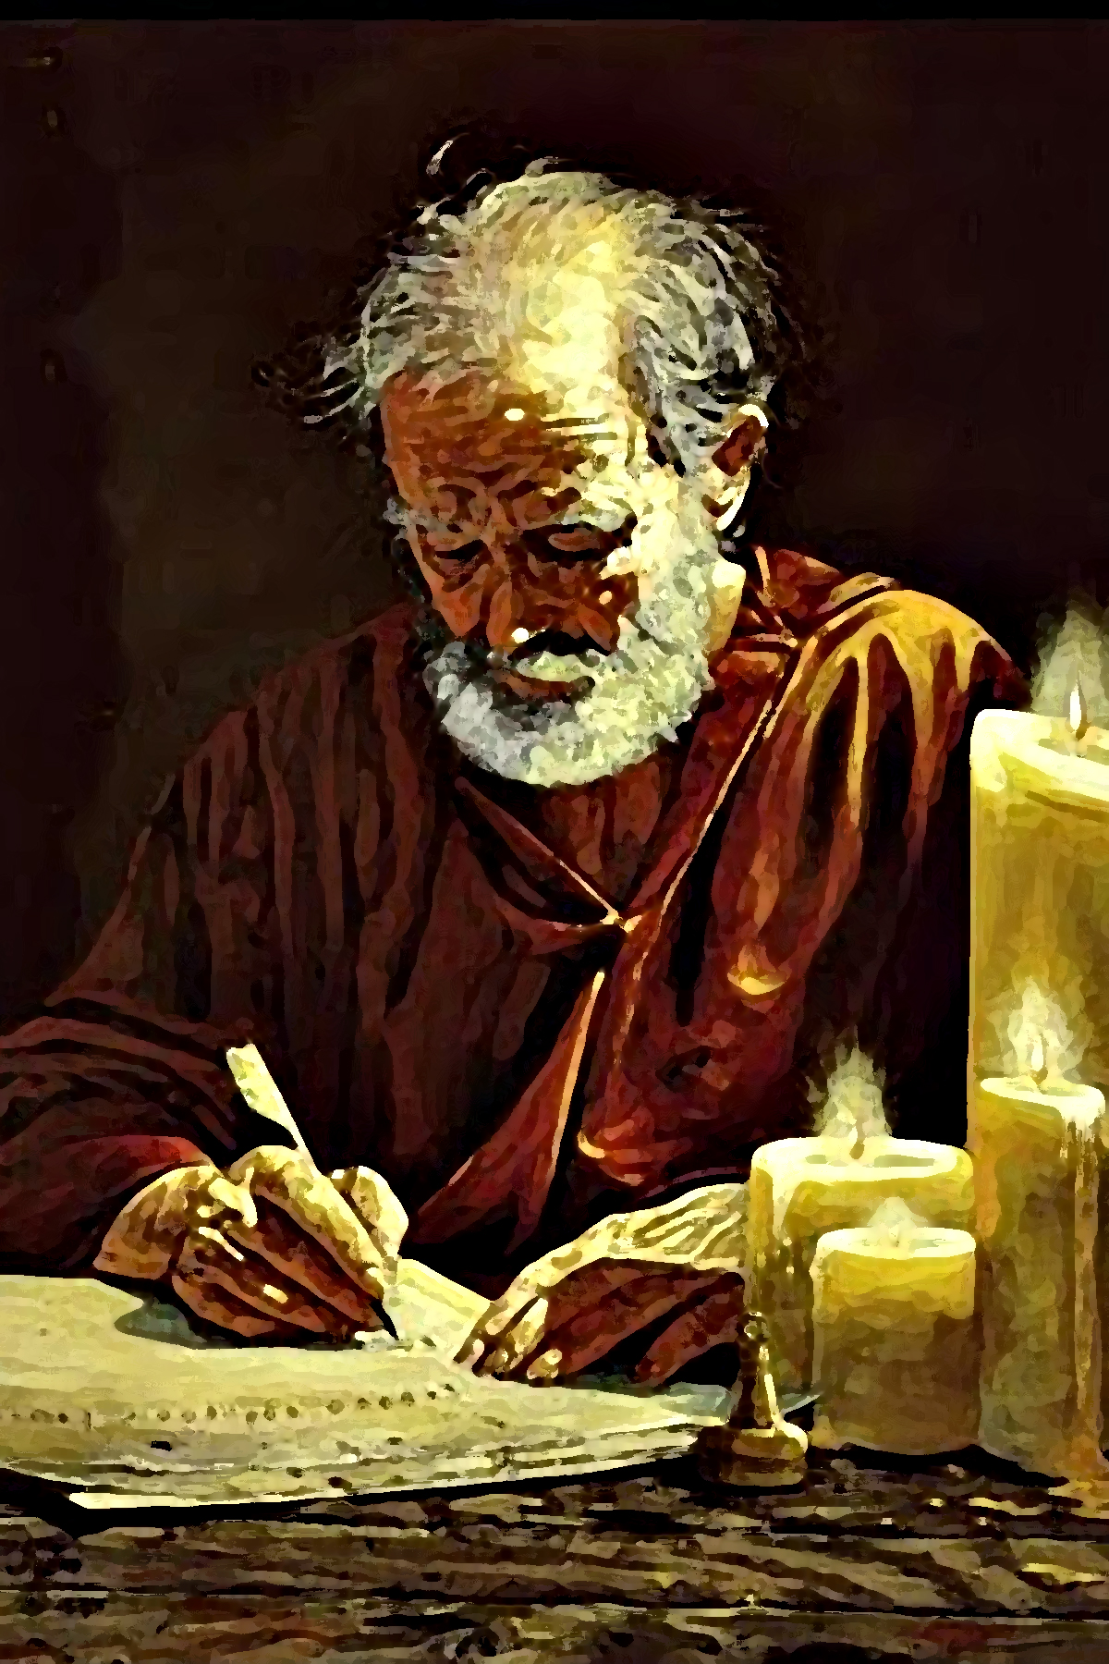
Joyful and Confident
³ I thank my God in all my remembrance of you,
⁴ always offering prayer with joy in my every prayer for you all,
⁵ in view of your participation in the gospel from the first day until now.
⁶ For I am confident of this very thing, that He who began a good work in you will perfect it until the day of Christ Jesus.
Philippians 1:3-6

Slide 3
One Day… We’ll Be Together
^{Paul continues:}
⁷ It is right for me to feel this way about you all, because I hold you in my heart, for you are all partakers with me of grace, both in my imprisonment and in the defense and confirmation of the gospel.
⁸ For God is my witness, how I yearn for you all with the affection of Christ Jesus.
Philippians 1:7-8

Slide 4
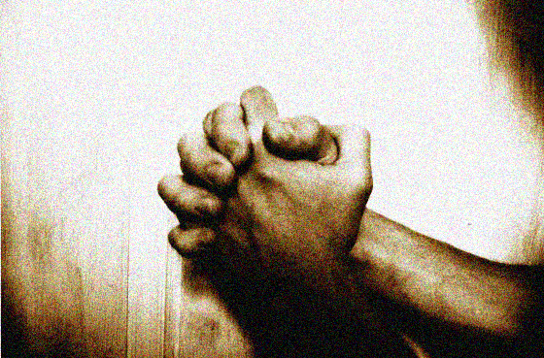
Paul’s Prayer… for you
⁹ And this I pray, that your love may abound still more and more in real knowledge and all discernment,
¹⁰ so that you may approve the things that are excellent, in order to be sincere and blameless until the day of Christ;
¹¹ having been filled with the fruit of righteousness which comes through Jesus Christ, to the glory and praise of God.
Phil. 1:9-11

Slide 5
The Potency of Specificity
Notice what Paul doesn’t pray for:
Strength
Blessing
Revival
Unity
Conviction of sin
Paul knew exactly what he was requesting
True prayer warriors are very intentional and specific in their requests
“This I pray, that… so that you…”
What about your own prayer life?
Generic?
Or Specific?

Slide 6
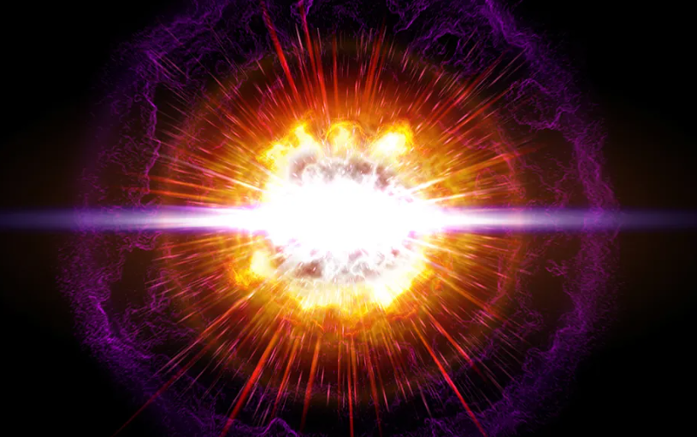
That your LOVE…
May ABOUND…
Still MORE…
… and MORE!

Slide 7
A Sliding Scale of Selflessness
Honest appraisal: Where are YOU right now on this scale?
Grotesquely self-absorbed
Bit of a whiney brat that doesn’t read the room well
Known for occasional acts of spontaneous kindness
You simply live to serve others day in, day out
Wherever you are – any single one of these places – there’s still room to grow
This is what Paul means by ABOUNDING in love

Slide 8
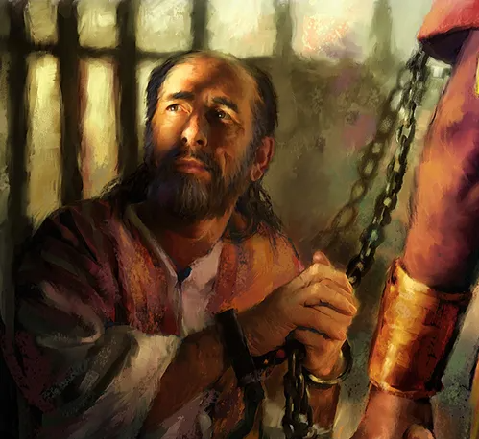
As I Languish in These Chains…
Intriguing to note not only the content of Paul’s prayer, but also the context in which he wrote it
THIS is my prayer for you… my faithful, generous friends
It was John’s exhortation to us too – his dying words
Even Jesus Himself: The world is watching & taking note
By this EVERYONE will know that you are my disciples, if you LOVE ONE ANOTHER. (John 13:35)

Slide 9
But How Now Shall We Love?
Paul qualifies and characterizes this super-abounding love:
… that your love may abound still more and more in real knowledge and all discernment (Phil 1:9)
Not just a growth in our love of knowledge (with apologies to scholars & seminary professors)
This is loving others in knowledge… REAL knowledge
Love that truly and knows seeks to understand the object of your affection
In other words, pay attention! Antenna up high! Seek new insights

Slide 10
Let’s Get Practical: LOVING WELL
First name basis
‘FaceTime’: Lock eyes… phone down… undivided attention
Do you know how rare this is today?
Converse! The Christian faith is a verbal faith
Become an expert question-asker, just as Jesus was
So you can know and discern and gain insight
Listen more, talk less
But when you do talk, lead them to the Word and to the Cross
Be genuinely interested
Right now, as I sit across this table from you, you are the single most important person in the world to me
What would you add to this list?

Slide 11
Six Words That Could Change Your Life
Wherever you are,
be all there.
Missionary martyr Jim Eliot

Slide 12
The Purpose and the Outcome
… so that you may approve the things that are excellent… (Philippians 1:10)
Christian Faith 101: difference between right and wrong
But according to Paul, we can go deeper still:
As we learn to love people with more intentionality and insight, we discover something new and very cool
Ability to discern not just right from wrong, but between that which is merely good from what’s excellent – the highest, greatest, strongest, richest, and most profound
All of this… in our OWN lives!
So tell me: How does that play out in the real world?

Slide 13
Sincere and Blameless
… in order to be sincere and blameless until the day of Christ, having been filled with the fruit of righteousness which comes through Jesus Christ, to the glory and praise of God. (Phil. 1:10-11)
What does our loving well, and our increasing ability to discern the ‘excellent’ things, have to do with our sincerity & moral character?
Remember all those things Paul didn’t pray for?
He didn’t need to pray for them, because he knew the outcome of LOVING WELL results in them anyway!

Slide 14
A Lifetime of Encouragement
Here’s a challenge that absolutely blew my mind:
See to it, brothers and sisters, that none of you has a sinful, unbelieving heart that turns away from the living God. But encourage one another daily, as long as it is called “Today,” so that none of you may be hardened by sin's deceitfulness.
Hebrews 3:12-13
What’s the warning here?
What’s the command (really, the remedy) here?
Everyone agree that having strong fellowship and accountability helps keep us away from sin?
But is that really what this passage is about?

Slide 15
Like a Branch on the True Vine
Jesus has always taught the importance of bearing fruit
“I am the True Vine, you are the branches… abide in Me!”
When Paul lists the fruit of the Spirit in Galatians 5, which characteristic comes first?
Back to Paul’s prayer in Philippians 1 – here’s how he ends:
… filled with the fruit of righteousness which comes through Jesus Christ, to the glory and praise of God.
Love is inextricably connected with ALL fruit-bearing
Does loving others serve as the catalyst for bearing fruit?
Or does this “fruit of righteousness” result in loving well?
All to the GLORY and PRAISE of GOD!

Slide 16
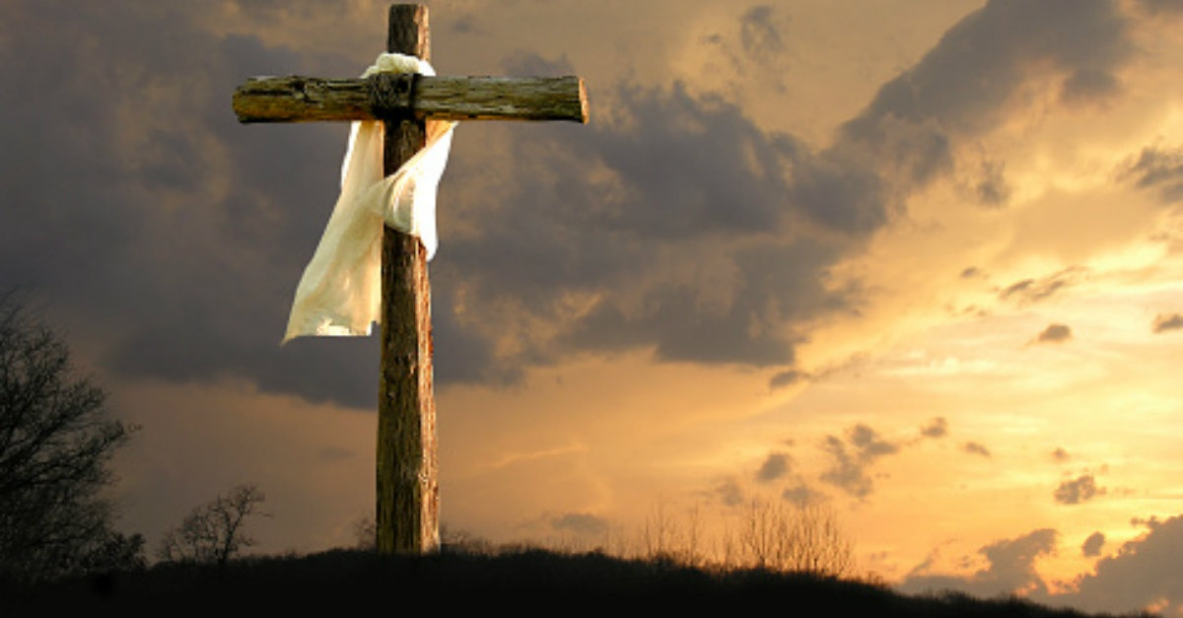
There Are Only Two Kinds of People
“Here I am!”
“There you are!”

Slide 17
HOW NOW SHALL WE LOVE?

Slide 18
Q&A

